Slide 1
Universal Adversarial Perturbations (Universal)
Seyed-Mohsen Moosavi-Dezfooli（proposed DeepFool） Ecole Polytechnique F 'ed ' erale de Lausanne
2017 CVPR

Slide 2
Outline
Scenario
Observe Imagine
Problem
Multiple Angles
Solution
Theory Tool
Performance
Effectiveness Cost

Slide 3
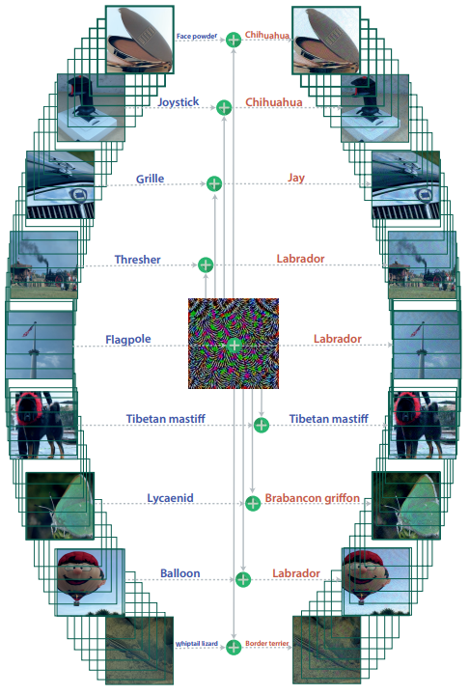
1
Scenario & Problem
Scenario
a single image perturbation that fools a deep neural network classifier on all natural images?
a single image perturbation that fools many deep neural network classifiers?
Problem
All of prior adversarial perturbations have intrinsic dependence on datapoints: the perturbations are specifically crafted for each data point independently.
Reference: L-BFGS\Deepfool\FGSM

Slide 4
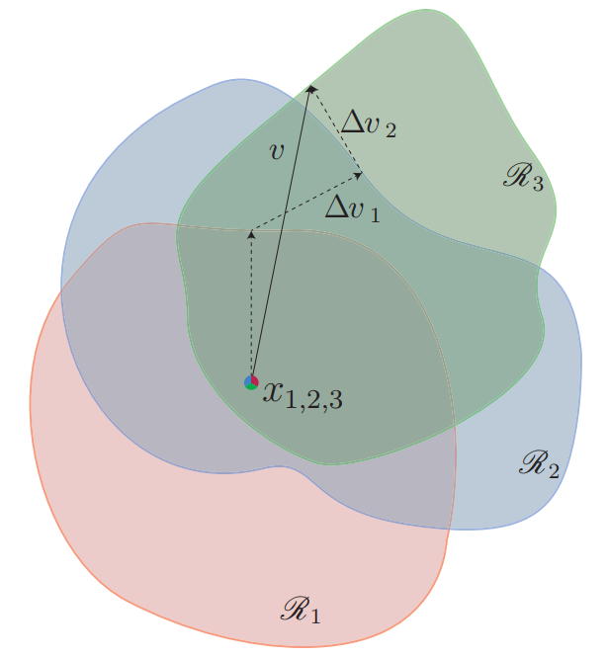
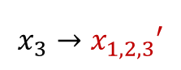
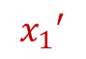
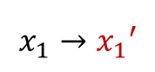
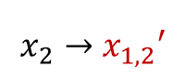
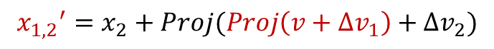
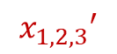
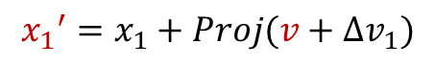
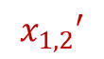
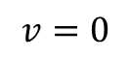
Theory
3
Solution
How to estimate the universal perturbation?
Visualization：
$${x_{1,2,3}}^{′}$$
Initial
$$v=0$$
$${x_{1,2}}^{′}$$
Iteration 1st
$$x_{1}→{x_{1}}^{′}$$
$${x_{1}}^{′}=x_{1}+Proj(v+∆v_{1})$$
$${x_{1}}^{′}$$
$$x_{2}→{x_{1,2}}^{′}$$
$${x_{1,2}}^{′}=x_{2}+Proj(Proj\left(v+∆v_{1}\right)+∆v_{2})$$
Iteration 2nd
$$x_{3}→{x_{1,2,3}}^{′}$$
$${x_{1,2,3}}^{′}=x_{3}+Proj(Proj\left(Proj\left(v+∆v_{1}\right)+∆v_{2}\right)+∆v_{3})$$
Iteration 3rd
How to project the universal perturbation on the $l_{p}$ ball of radius $ξ$?

Slide 5
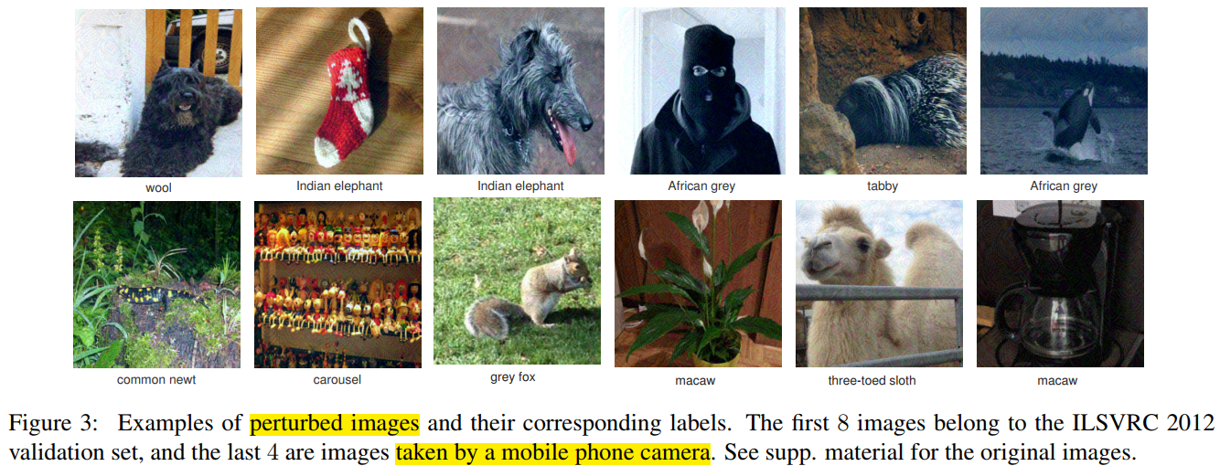
4
Performance

Slide 6
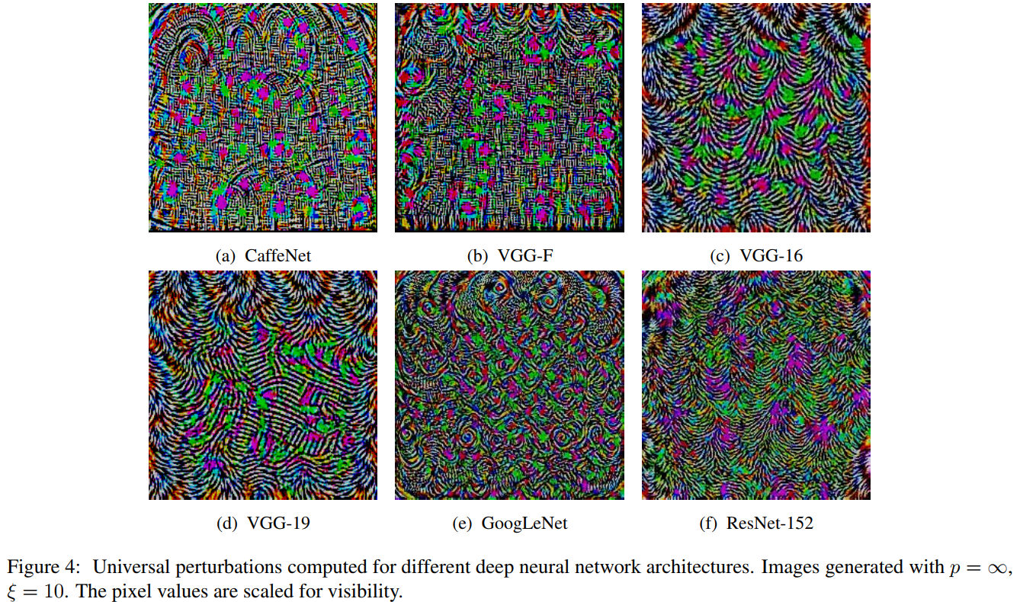
4
Performance

Slide 7
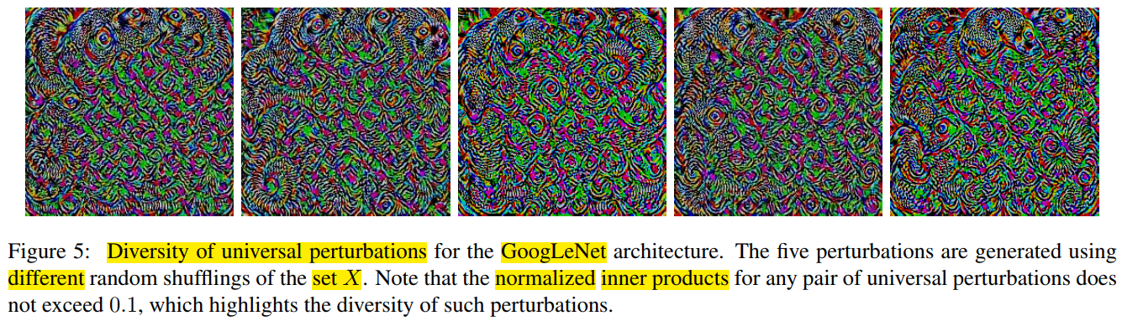
4
Performance

Slide 8
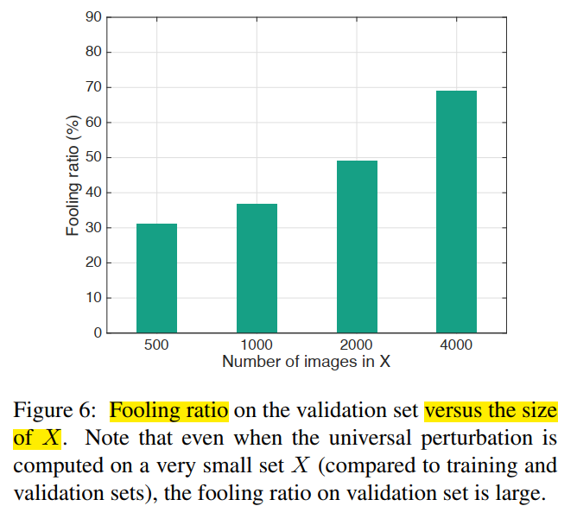
4
Performance

Slide 9
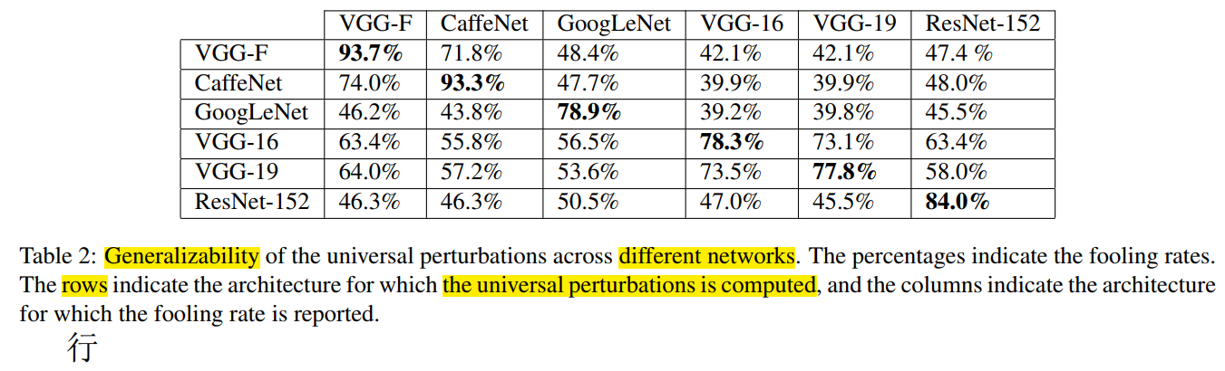
4
Performance

Slide 10
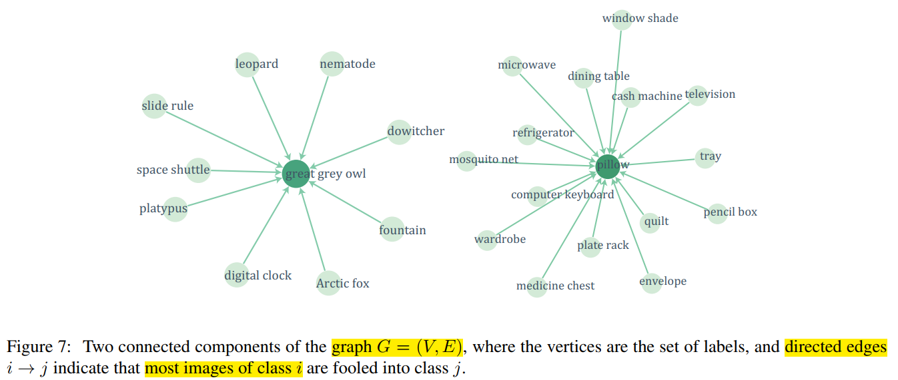
4
Performance

Slide 11
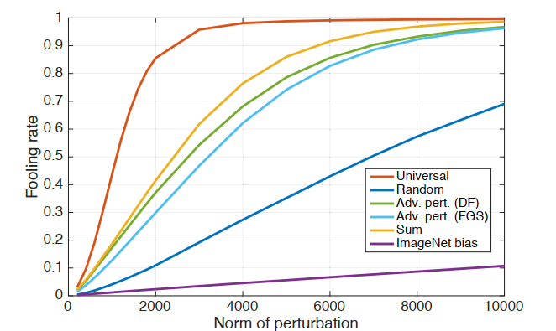
4
Performance

Slide 12
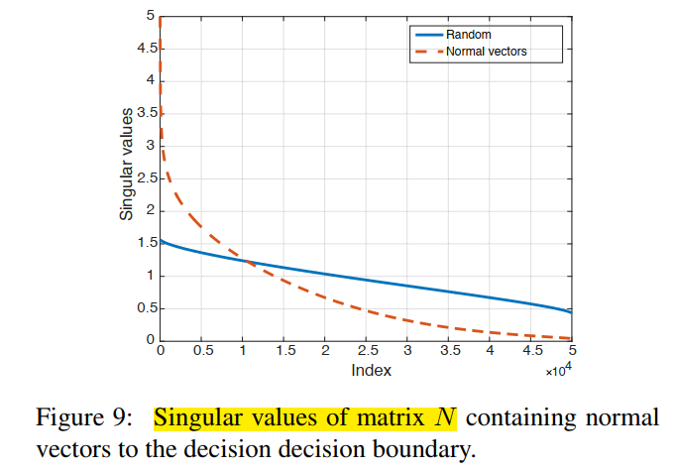
4
Performance

Slide 13
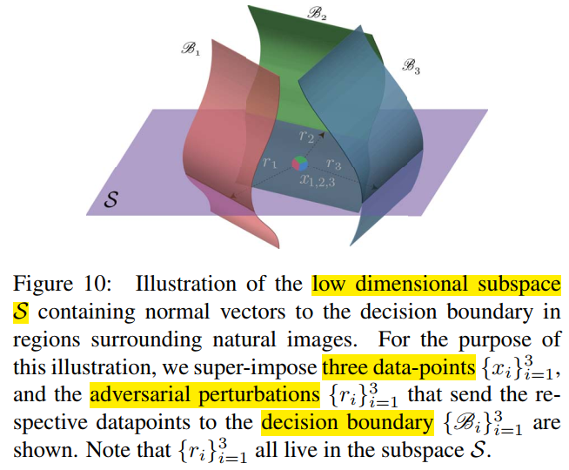
4
Performance

Slide 14
4
Conclusion
叠加每一张image的扰动。最后用投影缩放扰动，控制在范数距离约束内。

